Slide 1
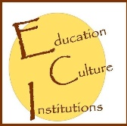
International Conference “New Perspectives in Science Education” – 11th Edition
 17 – 18th March 2022, Florence, Italy 
Cultural Institutions and Education in Bulgaria –
Popularization of Programs
with a Scientific and Research Project
Svetoslava Dimitrova, PhD
Chief Assist. Sonya Spasova, PhD
Simona Dusheva, Master’s Student
Panayot Gindev, PhD Student
University of Library Studies and Information Technologies (ULSIT)
Sofia, BULGARIA
Notes:
1

Slide 2
1. Introduction
2. Methodology
3. Results
4. Conclusions
5. Acknowledgments
6. Contacts with the authors
Structure of the presentation
Cultural Institutions and Education in Bulgaria – Popularization of Programs with a Scientific and Research Project
Svetoslava Dimitrova, Sonya Spasova, Simona Dusheva, Panayoit Gindev

Slide 3
1. Introduction
Because of the role of cultural heritage and its inextricable link with education, the best way to learn about it is to "touch" it and this is possible thanks to cultural institutions such as museums, libraries, archives, etc.
This is the goal of the research project on title: “Research of contemporary educational programs of cultural institutions in Bulgaria”, developed by team from the University of Library Studies and Information Technologies – Bulgaria.
The project examines museums and libraries as symbols of institutions preserving the rich national cultural heritage and the education strategies they implement.
Cultural Institutions and Education in Bulgaria – Popularization of Programs with a Scientific and Research Project
Svetoslava Dimitrova, Sonya Spasova, Simona Dusheva, Panayoit Gindev

Slide 4
2. Methodology
The goal of this paper is to present project website, which serves as an information portal, as it provides links to educational programs and initiatives of all regional history museums and regional libraries in Bulgaria by territorial and thematic scope, as one of the main activities of the project is to promote the activities of these cultural institutions in order to reach the general public and show the other side of these institutions - as a place for entertainment in an educational environment.
Cultural Institutions and Education in Bulgaria – Popularization of Programs with a Scientific and Research Project
Svetoslava Dimitrova, Sonya Spasova, Simona Dusheva, Panayoit Gindev

Slide 5
3. Results
In order to ensure public awareness and transparency about the goals, objectives and expected results of the project, a website is created. Designing, maintaining, and updating it is a top priority in the project management activities.
The website is structured as follows:
Cultural Institutions and Education in Bulgaria – Popularization of Programs with a Scientific and Research Project
Svetoslava Dimitrova, Sonya Spasova, Simona Dusheva, Panayoit Gindev

Slide 6
3. Results
As part of the website is created a database (Page “Museums and Libraries”) that aims to provide visitors with easy access to information about the educational programs of cultural institutions in Bulgaria, selected by territorial and thematic scope. These are the National History Museum, the National Library „St. St. Cyril and Methodius“, as well as all regional history museums and libraries in the country.
For this purpose, the institutions are systematized in six areas:
Southwest area – including Blagoevgrad, Kyustendil, Pernik, Sofia.
South Central area – including Kardzhali, Pazardzhik, Plovdiv, Smolyan, Haskovo.
Southeast area – including Stara Zagora, Sliven, Yambol, Burgas.
Northeast area – including Varna, Dobrich, Targovishte, Shumen.
North Central area – including Veliko Tarnovo, Gabrovo, Razgrad, Ruse, Silistra.
Northwest area – including Vidin, Vratsa, Montana, Pleven, Lovech.
Cultural Institutions and Education in Bulgaria – Popularization of Programs with a Scientific and Research Project
Svetoslava Dimitrova, Sonya Spasova, Simona Dusheva, Panayoit Gindev

Slide 7
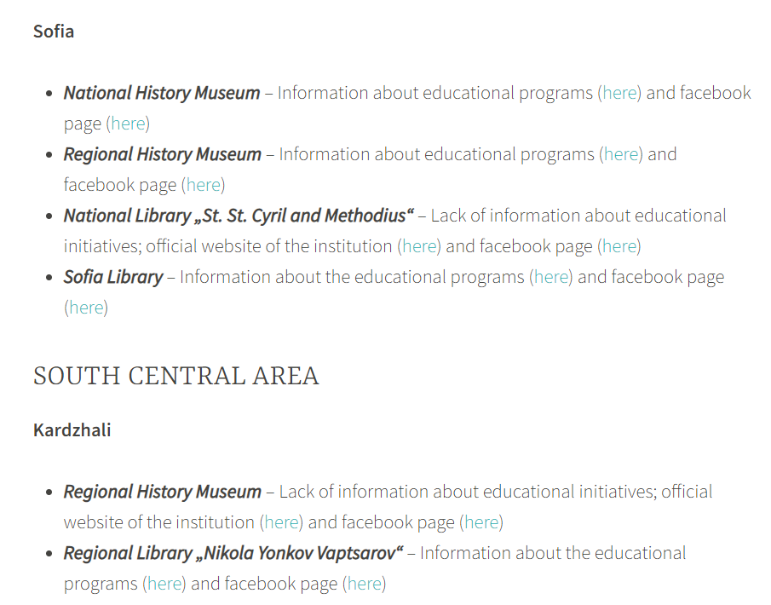
3. Results
They comply with the requirements of the common classification of territorial units for statistical purposes, applied in the European Union. For each institution is published a direct link to the offered educational programs (if available), as well as to their official page on the social network „Facebook“.
Museums and Libraries Database,
available at https://educulture.unibit.bg/museums-and-libraries/
Cultural Institutions and Education in Bulgaria – Popularization of Programs with a Scientific and Research Project
Svetoslava Dimitrova, Sonya Spasova, Simona Dusheva, Panayoit Gindev

Slide 8
3. Results
As another result of the project activities is an Interactive Map, in which users could find information about the educational programs of cultural institutions in Bulgaria, selected by territorial and thematic scope.
The interactive map again marks the regional history museums and regional libraries in the six areas.
The pins of the regional libraries are blue, and pins of the regional history museums are red.
The National History Museums is marked in yellow and the National Library in green – both located in Sofia.
The interactive map offers information about each of the examined cultural institutions, which includes:
a link to the institution's website and to educational programs and initiatives
what target groups they are aimed at
link to a Facebook page
contacts - phone and email
Cultural Institutions and Education in Bulgaria – Popularization of Programs with a Scientific and Research Project
Svetoslava Dimitrova, Sonya Spasova, Simona Dusheva, Panayoit Gindev

Slide 9
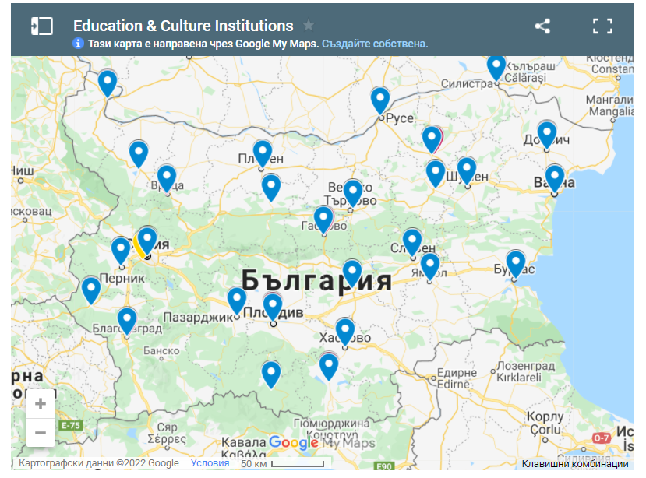
3. Results
Cultural Institutions and Education in Bulgaria – Popularization of Programs with a Scientific and Research Project
Svetoslava Dimitrova, Sonya Spasova, Simona Dusheva, Panayoit Gindev

Slide 10
4. Conclusion
In the classroom, educators can present information to students many ways, whether via lecture, video, or readings. Field trips can not only entertain, but they also serve as a supplement for material discussed in class. Physically surrounded by elements that they have previously been taught allows students to connect the visual with their class experiences. When both iterations of the same information are merged, a complete understanding of the subject matter is more easily achieved by the student, allowing them to successfully further their education.
The presentation of these cultural institutions and their educational activities to national and international scientific audience would help to enhance the prestige of Bulgaria as a country with rich cultural heritage, preserved traditions and active cultural and educational activities. Promoting their activities and presenting them in a convenient format for the end user (parent, student, etc.) will further increase their attendance and show their interactive side.
Cultural Institutions and Education in Bulgaria – Popularization of Programs with a Scientific and Research Project
Svetoslava Dimitrova, Sonya Spasova, Simona Dusheva, Panayoit Gindev

Slide 11
5. Acknowledgments
This research would not be possible without the financial assistance of the following project: “Research of contemporary educational programs of cultural institutions in Bulgaria”, financed by National Science Fund of the Ministry of Education and Science of the Republic of Bulgaria with Contract № KP-06-M35/3 from 18.12.2019, led by Assist. Sonya Spasova, PhD.
For more information:
Official website of the project – https://educulture.unibit.bg/ Facebook page – https://www.facebook.com/eduCulturebg
Cultural Institutions and Education in Bulgaria – Popularization of Programs with a Scientific and Research Project
Svetoslava Dimitrova, Sonya Spasova, Simona Dusheva, Panayoit Gindev
17

Slide 12
Thank you for your attention!
Chief Assist. Sonya Spasova, PhD
s.spasova@unibit.bg
Svetoslava Dimitrova, PhD
s.dimitrova@unibit.bg
Simona Dusheva, Master’s student
s.dusheva@unibit.bg
Panayot Gindev, PhD student
p.gindev@unibit.bg
Cultural Institutions and Education in Bulgaria – Popularization of Programs with a Scientific and Research Project
Svetoslava Dimitrova, Sonya Spasova, Simona Dusheva, Panayoit Gindev
Notes:
12

