Slide 1
13th annual International Conference on Education and New Learning Technologies 5th – 6th July 2021
QUANTITATIVE AND QUALITATIVE CHARACTERISTICS OF CONTEMPORARY MUSEUM EDUCATIONAL PROGRAMS
Svetoslava Dimitrova, PhD
Chief Assist. Sonya Spasova, PhD
University of Library Studies and Information Technologies
Sofia, BULGARIA

Slide 2
STRUCTURE OF THE PRESENTATION
INTRODUCTION
METHODOLOGY
RESULTS
Summary results for frequency of implementation and applied pedagogical approaches
Connection of museum educational programs and initiatives with some scientific fields and categories of cultural heritage
Organizational and institutional aspect. Target groups
CONCLUSIONS
ACKNOWLEDGEMENTS
CONTACT WITH THE AUTHORS
QUANTITATIVE AND QUALITATIVE CHARACTERISTICS OF CONTEMPORARY MUSEUM EDUCATIONAL PROGRAMS
Sonya Spasova, Svetoslava Dimitrova

Slide 3
INTRODUCTION
The museum environment ensures the realization of the pedagogical process by assisting in the acquisition of new knowledge, the development of creative thinking and communication skills. Education is no longer just about books and textbooks; it crosses the boundaries of school and university and builds new knowledge and skills in people with the help of various educational initiatives offered by cultural institutions. We all notice that museums are changing.
The development of information technologies has called into question the traditional model of museums and libraries. They are no longer just passive “learning spaces” for public access to “knowledge” as an exchange between teacher and trainee, or in this context a curator and visitor .
QUANTITATIVE AND QUALITATIVE CHARACTERISTICS OF CONTEMPORARY MUSEUM EDUCATIONAL PROGRAMS
Sonya Spasova, Svetoslava Dimitrova

Slide 4
Methodology
The study aims to present summary data on educational programs and initiatives conducted in 27 regional historical museums in Bulgaria in 2019. The basis of the study is accessible and visible to visitors’ information about them, published on the official websites of these institutions.
In the presented results it is admissible to consider statistical deviations, but despite them the main tendencies in relation to the modern education in the museum environment in pre-selected directions stand out. They are related to the frequency of implementation, the pedagogical methods and forms used, as well as their relationship with certain sciences or scientific fields.
QUANTITATIVE AND QUALITATIVE CHARACTERISTICS OF CONTEMPORARY MUSEUM EDUCATIONAL PROGRAMS
Sonya Spasova, Svetoslava Dimitrova

Slide 5
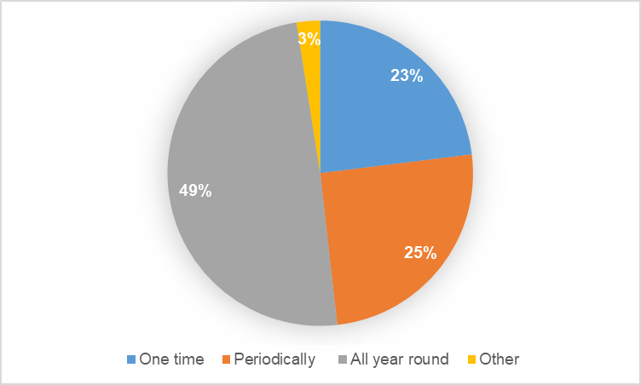
results
Summary results for frequency of implementation and applied pedagogical approaches
A total of 186 proposed programs and educational initiatives were conducted for 2019 in 27 museums. The main conclusions of the analysis demonstrate the diversity of pedagogical approaches used for non-formal education in the museum environment.
The study identifies the existence of two main sustainable categories of educational programs. The first ones are held all year round and are related to the permanent exposition of the museum (49%). The others of this type are characterized by periodicity and are related to the traditional holiday calendar. In addition to the permanent programs, there is a tendency to conduct one-time educational initiatives.
QUANTITATIVE AND QUALITATIVE CHARACTERISTICS OF CONTEMPORARY MUSEUM EDUCATIONAL PROGRAMS
Sonya Spasova, Svetoslava Dimitrova

Slide 6
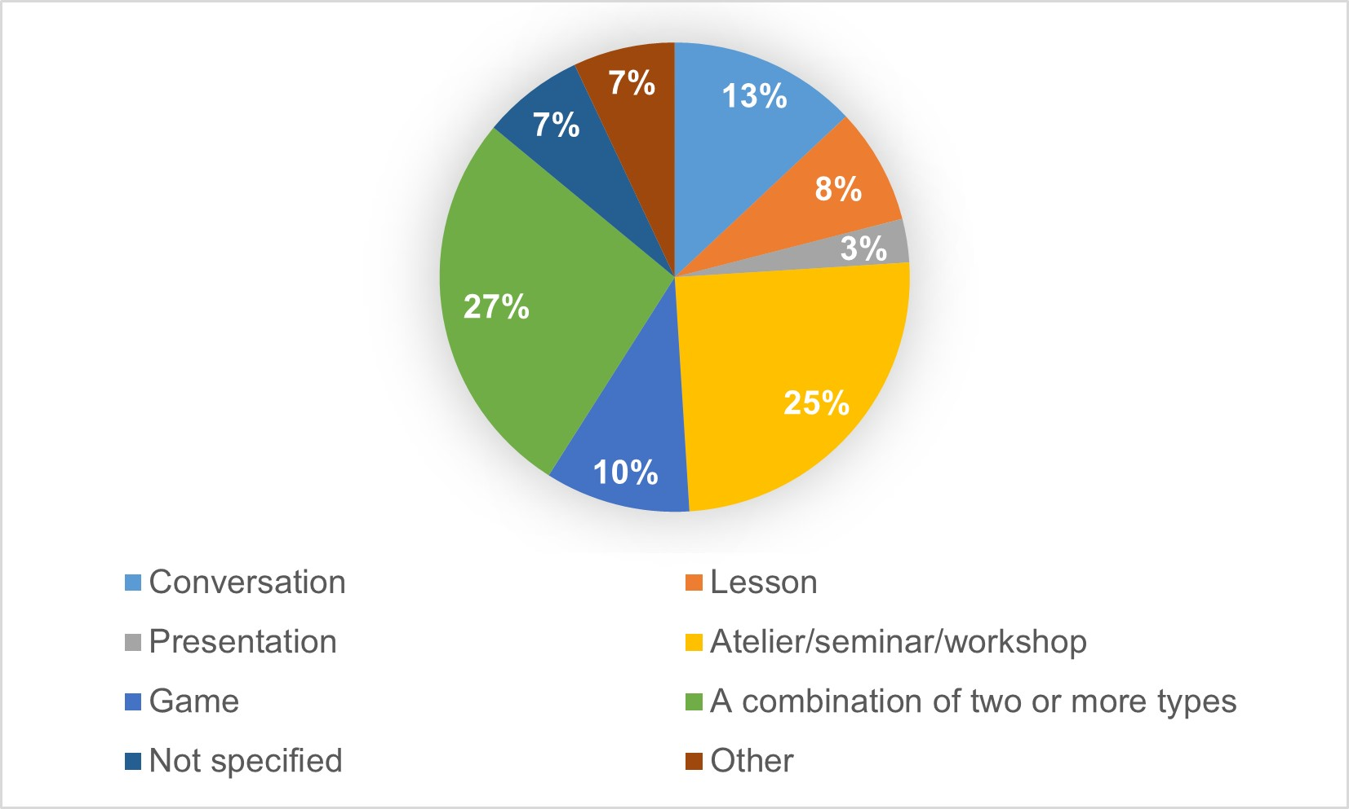
results
Summary results for frequency of implementation and applied pedagogical approaches
The applied educational methods according to the source of information is related to are the next direction, which are as follows: Verbal (story, talk, lesson); Visual (observation, demonstration); Practical (exercises, practical classes).
With a small lead, but with the highest share are those that combine different methods, which in most cases combine verbal with practical activities. Their variability regarding the specific forms of educational activities is extremely diverse, and the following activities can be indicated. Conversation; Lesson; Presentation; Atelier/seminar/workshop; Game; Competition. There are cases where a combination of the listed methods is used.
QUANTITATIVE AND QUALITATIVE CHARACTERISTICS OF CONTEMPORARY MUSEUM EDUCATIONAL PROGRAMS
Sonya Spasova, Svetoslava Dimitrova

Slide 7
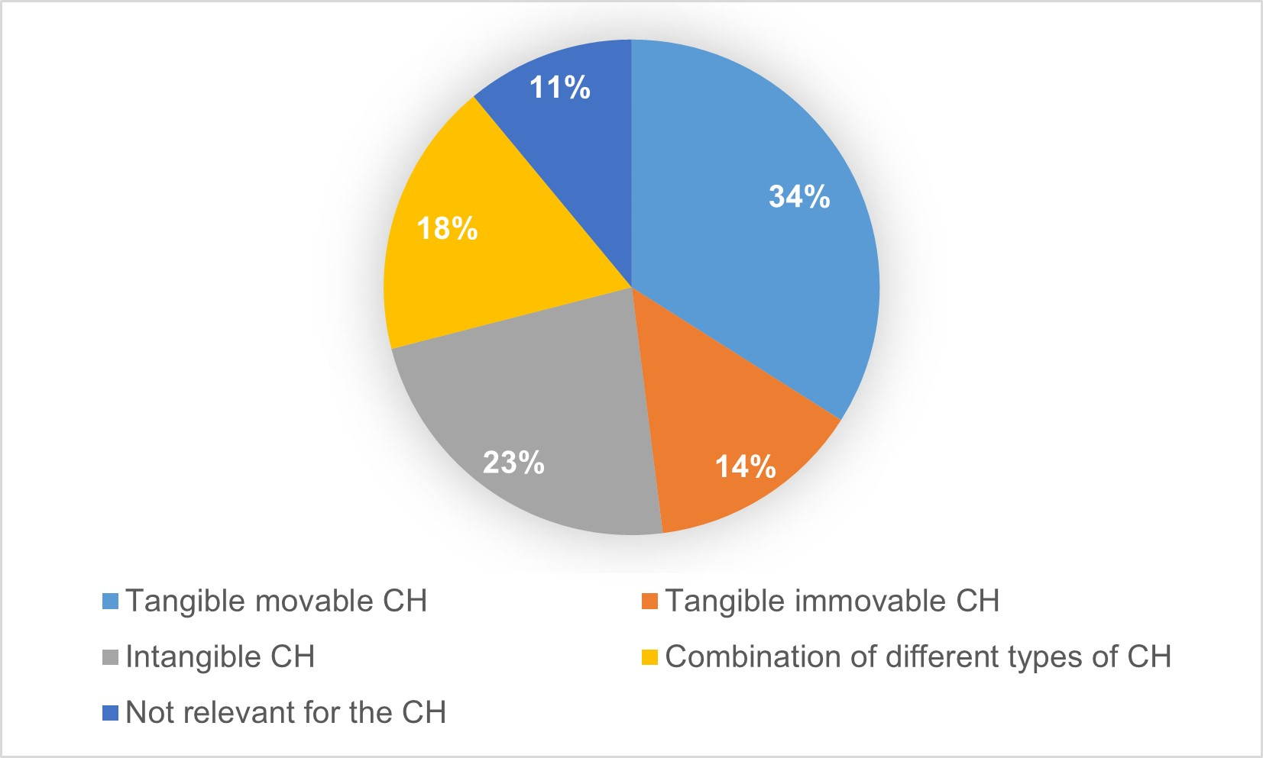
results
Connection of museum educational programs and initiatives with some scientific fields and categories of cultural heritage
An interesting finding, due to the fact that museums are mostly associated with the tangible movable cultural heritage is that in the studied educational programs and initiatives in second place determines their relationship with the ethnography of Bulgaria. This scientific field has a direct bearing on the customs, traditions, beliefs, way of life and crafts that are an element of the intangible cultural heritage. As a result, it can be determined that the museum environment has an exceptional role in its preservation and promotion. Examples related to architecture, geography, biology, theology, and museology are also found.
QUANTITATIVE AND QUALITATIVE CHARACTERISTICS OF CONTEMPORARY MUSEUM EDUCATIONAL PROGRAMS
Sonya Spasova, Svetoslava Dimitrova

Slide 8
results
Organizational and institutional aspect. Target groups
Inter-institutional cooperation in the field of museum education is important and a systematic state policy in this direction should be implemented. One of the examples that support this statement is the conduct of extracurricular activities in a museum environment.
Logically, the analysis of the results shows that the highest degree of regional museums is visited by schools in the region. However, to what extent these visits support the quality of formal education remains to be analysed.
If a museum program is aimed at formal (institutional) education at school or university, it should meet the set educational goals at the level of specific curricula and educational standards.
QUANTITATIVE AND QUALITATIVE CHARACTERISTICS OF CONTEMPORARY MUSEUM EDUCATIONAL PROGRAMS
Sonya Spasova, Svetoslava Dimitrova

Slide 9
results
Organizational and institutional aspect. Target groups
One aspect of this research is to provides the designation of specific target groups to which a museum educational program is directed, according to the following criteria: Educational indication (45%), Age sign (19%), Family and kinship indication (2%), Combination of indications (22%). In 12% of cases no target group is specified. For each group, information is noted in detail (specific age group, or stage of training).
QUANTITATIVE AND QUALITATIVE CHARACTERISTICS OF CONTEMPORARY MUSEUM EDUCATIONAL PROGRAMS
Sonya Spasova, Svetoslava Dimitrova

Slide 10
results
Organizational and institutional aspect. Target groups
The study found that according to its description, the highest share of museum programs is directed to the initial stage from I to IV grade (27%). In 13% of the cases there are also activities for children from the preschool education system. However, very few of these initiatives are related to the junior high school (9%) and high school (4%) stages, which cover the period of study from V to ХІІ grade. In only 2% of cases, information is found on programs aimed at people with special educational needs.
What the study finds, and which could be considered as a shortcoming in determining the target group on educational grounds, is that 26% of museum programs note that they are aimed at the general category of “students”. A similar trend is found in the age groups – in 49% of cases, they are referred to the generalizing concept of “children”. It is advisable to consider the curriculum for the respective stage, as well as the characteristics of the psychological and physiological development of different age groups, so that museum educational activities can be specified, attract specific audiences, and support formal and non-formal education.
QUANTITATIVE AND QUALITATIVE CHARACTERISTICS OF CONTEMPORARY MUSEUM EDUCATIONAL PROGRAMS
Sonya Spasova, Svetoslava Dimitrova

Slide 11
results
Organizational and institutional aspect. Target groups
The Lifelong Learning Strategy adopted in Bulgaria in 2014 recognizes the need to apply an educational approach that helps adults to continuously develop as enterprising individuals. The measures taken in Bulgaria are related to the creation of an educational environment that enables adults, regardless of their personal, social, or economic situation, to acquire, enrich and develop throughout their life’s specific skills and key competencies necessary for their employability.
One of the conditions for achieving the goals thus formulated is to ensure that all learners acquire knowledge and skills about cultural diversity and the contribution of culture to the sustainable development of society. Regional historical museums have an irreplaceable resource in this regard. Unfortunately, the current study does not find museum educational programs specifically targeted at groups in early adulthood (20-40 years), adulthood (41-65 years) or maturity (65+ years). It is advisable to make reforms in this regard.
QUANTITATIVE AND QUALITATIVE CHARACTERISTICS OF CONTEMPORARY MUSEUM EDUCATIONAL PROGRAMS
Sonya Spasova, Svetoslava Dimitrova

Slide 12
Conclusions
The use of all that technology offer is the right way to preserve and promote CHH. Within the UN – UNESCO and the EU, cultural heritage is a basic factor for the formation of policy not only for intercultural integration, but also for sustainable development of individual countries through effective and efficient socialization of cultural values. Regional history museums can support these processes.
The main conclusions of the conducted study report good practices in terms of diversity both thematically and in the application of innovative and attractive pedagogical approaches to conducting museum educational programs and initiatives. However, it is necessary to specify the criteria for determining the target groups to which they are aimed to achieve better results in terms of formal and non-formal education.
QUANTITATIVE AND QUALITATIVE CHARACTERISTICS OF CONTEMPORARY MUSEUM EDUCATIONAL PROGRAMS
Sonya Spasova, Svetoslava Dimitrova

Slide 13
ACKNOWLEDGEMENTS
This research would not be possible without the financial assistance of the following project: “Research of contemporary educational programs of cultural institutions in Bulgaria”, financed by National Science Fund of the Ministry of Education and Science of the Republic of Bulgaria with Contract № KP-06-M35/3 from 18.12.2019, led by Assist. Sonya Spasova, PhD.
For more information: Official website of the project – https://educulture.unibit.bg/; Facebook page – https://www.facebook.com/eduCulturebg
QUANTITATIVE AND QUALITATIVE CHARACTERISTICS OF CONTEMPORARY MUSEUM EDUCATIONAL PROGRAMS
Sonya Spasova, Svetoslava Dimitrova

Slide 14
Thank you for your attention!
Svetoslava Dimitrova, PhD
s.dimitrova@unibit.bg
Chief Assist. Sonya Spasova, PhD
s.spasova@unibit.bg
University of Library Studies and Information Technologies
Sofia, Bulgaria
QUANTITATIVE AND QUALITATIVE CHARACTERISTICS OF CONTEMPORARY MUSEUM EDUCATIONAL PROGRAMS
Sonya Spasova, Svetoslava Dimitrova

