Slide 1
EXPERIMENTAL METHODOLOGY FOR RESEARCH OF MUSEUM EDUCATIONAL PROGRAMS
15th annual International Technology, Education, and Development Conference
8th-9th March, 2021
Chief Assist. Sonya Spasova, PhD Antonii Stanimirov, PhD student
Arsini Kolev, PhD student
Assoc. Prof. Rositsa Krasteva, PhD
University of Library Studies and Information Technologies
Sofia, BULGARIA

Slide 2
Structure of presentation
INTRODUCTION
METHODOLOGY
RESULTS
First criterion: Location of the museum institution
Second criterion: Thematic scope
Third criterion: Organizational and institutional aspect
Fourth criterion: Target groups
CONCLUSIONS
ACKNOWLEDGEMENTS
CONTACT WITH THE AUTHORS
EXPERIMENTAL METHODOLOGY FOR RESEARCH OF MUSEUM EDUCATIONAL PROGRAMS Sonya Spasova, Antonii Stanimirov, Arsini Kolev, Rositsa Krasteva

Slide 3
INTRODUCTION
The main role for access to cultural values, i.e., for their socialization in the modern society, have cultural institutions. This paper proposes an experimental methodology for researching museum educational programs. It aims to outline the main directions for deriving categories related to quantitative and qualitative indicators on meeting certain educational needs. The object of research are the regional historical museums in the country, which are 27 in number, divided into six areas Nortwestern, North Central, Northeast, Southeast, Southwest and South Central areas.
In addition to museums, the cultural heritage system includes and some other organizations (archives, community centres, libraries, galleries, etc.), which have a common mission – conservation and preservation of the memory of human civilization. Knowledge of it – this is the essence of education in terms of cultural heritage and institutions are directly responsible for this. The proposed methodology for studying museum educational programs could be adapted in the future for the above-mentioned institutions, considering their specific characteristics.
EXPERIMENTAL METHODOLOGY FOR RESEARCH OF MUSEUM EDUCATIONAL PROGRAMS Sonya Spasova, Antonii Stanimirov, Arsini Kolev, Rositsa Krasteva

Slide 4
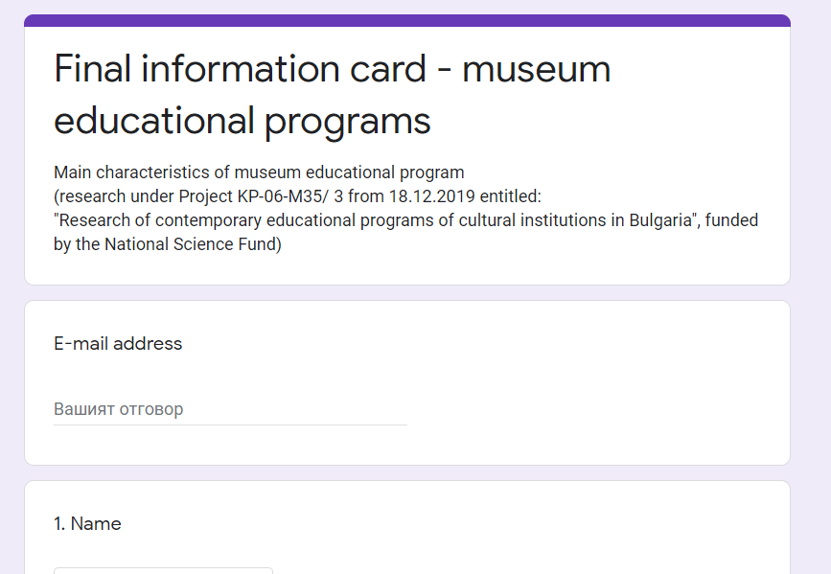
METHODOLOGY
For the purposes of this research, an approach was chosen for statistical processing and analysis of data related to quantitative and qualitative indicators regarding the conducted educational programs in Bulgarian museums in 2019.
The research team of the project selected the criteria to systematize some key features in the so-called “Information card”, positioned in Google Forms, which achieves a clear and fast systematization of the received data.
The information card contains two main sections.
The first covers general information of the museum’s educational program in the various areas.
The second section “Target groups” presents information about who the educational program is aimed at on the various grounds.
EXPERIMENTAL METHODOLOGY FOR RESEARCH OF MUSEUM EDUCATIONAL PROGRAMS Sonya Spasova, Antonii Stanimirov, Arsini Kolev, Rositsa Krasteva

Slide 5
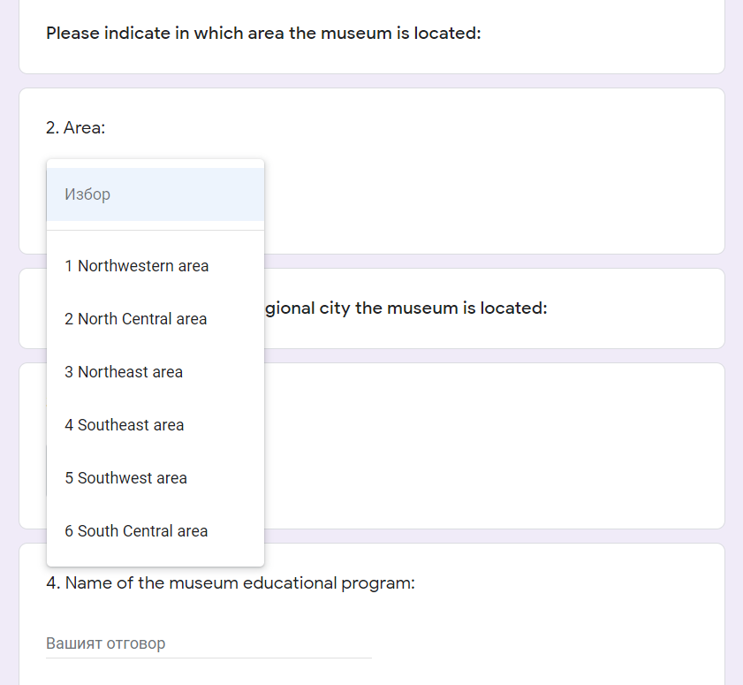
RESULTS
According to the Bulgarian legislation, the museum institutions research, preserve and present the cultural-historical values with cognitive, educational and aesthetic purpose. One of the factors that influences the choice of visiting a museum is its geographical location.
The Republic of Bulgaria is divided into six planning areas, each of which includes from 4 to 5 regional cities. In Art. 40 of the Cultural Heritage Act it is stated that each city has an independent regional history museum (a total of 27 for the country).
First criterion: Location of the museum institution
EXPERIMENTAL METHODOLOGY FOR RESEARCH OF MUSEUM EDUCATIONAL PROGRAMS Sonya Spasova, Antonii Stanimirov, Arsini Kolev, Rositsa Krasteva

Slide 6
RESULTS
Name of the museum educational program
The name guides users to the highlights and guidelines for the educational objectives of the program. The attractiveness of the name has a first signal influence on visitors when choosing them. During the research, extremely diverse names of educational programs stand out, which is a proof of the great resource that the museums in the country have at their disposal.
Educational methods and form of conducting
The next direction is related to the applied educational methods according to the source of information, which are as follows: Verbal (story, talk, lesson); Visual (observation, demonstration); Practical (exercises, practical classes). The information card also envisages a combination of the methods used in the educational programs, if any are applied.
Second criterion: Thematic scope
EXPERIMENTAL METHODOLOGY FOR RESEARCH OF MUSEUM EDUCATIONAL PROGRAMS Sonya Spasova, Antonii Stanimirov, Arsini Kolev, Rositsa Krasteva

Slide 7
RESULTS
Relation to science/scientific field and historical period
For the educational program to meet specific educational needs, the team set itself the goal of researching which sciences and/or scientific fields the individual programs are related to. During the approbation in filling in the information cards, the team reported a common phenomenon – the museum educational programs combine two consecutive historical periods.
Relation to a specific type of cultural heritage
In this thematic aspect the educational programs applied in the regional historical museums are categorized in its two main directions: tangible (movable and immovable) and intangible cultural heritage and/or their combinations
Relation to a specific type of art
Museum educational programs are highly child-centred, suggesting activities often related to the arts. One of the tasks of the research is to establish to which of them each educational initiative has (or does not have) relation, which will help parents and teachers in their choice.
Second criterion: Thematic scope
EXPERIMENTAL METHODOLOGY FOR RESEARCH OF MUSEUM EDUCATIONAL PROGRAMS Sonya Spasova, Antonii Stanimirov, Arsini Kolev, Rositsa Krasteva

Slide 8
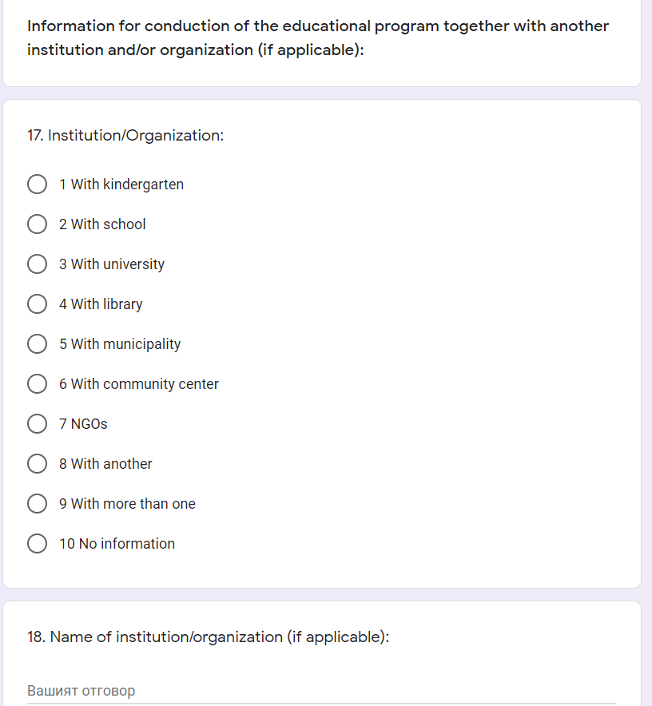
RESULTS
The information card indicates specific data whether the educational program is conducted jointly with another institution and/or organization. In the presence of joint initiatives, the type of the partner (for example: kindergarten, school, university, library, municipality, community centre, NGOs) and its name are noted.
To point out the good examples for financing educational programs in museum institutions through the applied state project policy, the name of the program/project and additional data are noted in the information card.
Third criterion: Organizational and institutional aspect
EXPERIMENTAL METHODOLOGY FOR RESEARCH OF MUSEUM EDUCATIONAL PROGRAMS Sonya Spasova, Antonii Stanimirov, Arsini Kolev, Rositsa Krasteva

Slide 9
RESULTS
If a museum program is aimed at formal (institutional) education at school or university, it should meet the set educational goals at the level of specific curricula and educational standards.
If the educational program is aimed at non-formal education, i.e., attracting an audience at their own will in their free time, then the target groups should be selected according to other criteria (age, interests, etc.).
The last section of the information card provides for the designation of specific target groups to which a museum educational program is directed, according to the following criteria: Educational indication, Age sign, Family and kinship indication, Combination of indications. For each group, information is noted in detail (specific age group, or stage of training).
Fourth criterion: Target groups
EXPERIMENTAL METHODOLOGY FOR RESEARCH OF MUSEUM EDUCATIONAL PROGRAMS Sonya Spasova, Antonii Stanimirov, Arsini Kolev, Rositsa Krasteva

Slide 10
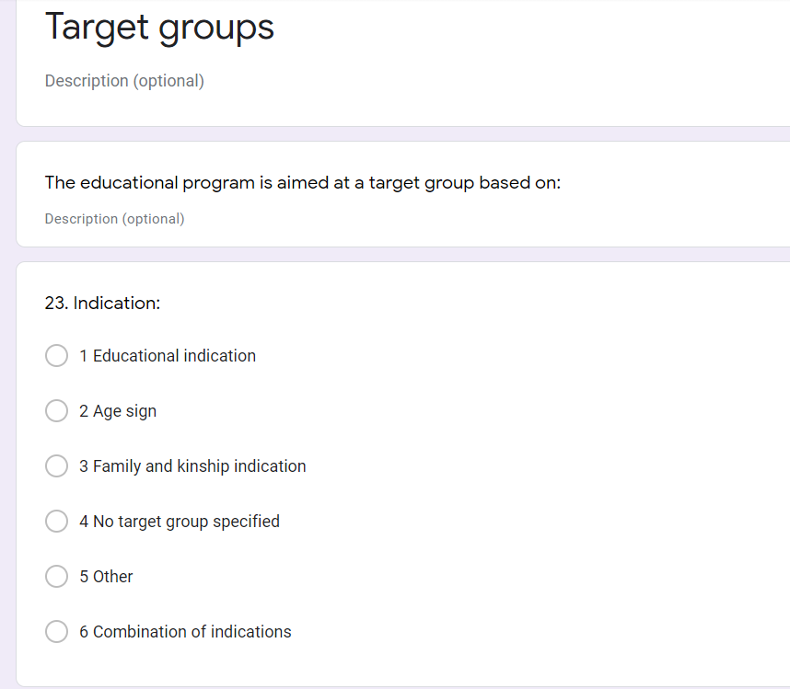
RESULTS
Other parts of the information card
EXPERIMENTAL METHODOLOGY FOR RESEARCH OF MUSEUM EDUCATIONAL PROGRAMS Sonya Spasova, Antonii Stanimirov, Arsini Kolev, Rositsa Krasteva

Slide 11
CONCLUSIONS
One of the main objectives of the present research is to promote ideas for inter-institutional cooperation for the socialization of cultural heritage and its integration into formal and non-formal education and lifelong learning. This type of research could also be useful on international level. Relationships in the fields of culture, science, education and the arts are a natural and historically determined social need, and in the modern world they are becoming one of the most significant subsystems of international relations.
The processes related to the globalization of relations and the development of information and communication technologies open opportunities for rapidly expanding mutual acquaintance of countries and peoples. Countries that have been historically linked and inextricably linked for centuries with a shared common cultural heritage.
EXPERIMENTAL METHODOLOGY FOR RESEARCH OF MUSEUM EDUCATIONAL PROGRAMS Sonya Spasova, Antonii Stanimirov, Arsini Kolev, Rositsa Krasteva

Slide 12
ACKNOWLEDGEMENTS
This research would not be possible without the financial assistance of the following project: “Research of contemporary educational programs of cultural institutions in Bulgaria”, financed by National Science Fund of the Ministry of Education and Science of the Republic of Bulgaria with Contract № KP-06-M35/3 from 18.12.2019, led by Chief Assist. Sonya Spasova, PhD.
For more information: Official website of the project – https://educulture.unibit.bg/; Facebook page – https://www.facebook.com/eduCulturebg
EXPERIMENTAL METHODOLOGY FOR RESEARCH OF MUSEUM EDUCATIONAL PROGRAMS Sonya Spasova, Antonii Stanimirov, Arsini Kolev, Rositsa Krasteva

Slide 13
THANK YOU FOR YOUR ATTENTION!
Contact with the authors:
Chief Assist. Sonya Spasova, PhD – e-mail: s.spasova@unibit.bg
Antonii Stanimirov, PhD student – e-mail: a.stanimirov@unibit.bg
Arsini Kolev, PhD student – e-mail: a.kolev@unibit.bg
Assoc. Prof. Rositsa Krasteva, PhD – e-mail: r.krasteva@unibit.bg
University of Library Studies and Information Technologies
Sofia, BULGARIA
EXPERIMENTAL METHODOLOGY FOR RESEARCH OF MUSEUM EDUCATIONAL PROGRAMS Sonya Spasova, Antonii Stanimirov, Arsini Kolev, Rositsa Krasteva

